Slide 1


STATISTICS IN MEDICINE IN MEDICINE, STATISTICS IS VITAL FOR CLINICAL TRIALS ,HELPING RESEARCHERS DETERMINE THE EFFICACY ANS SAFETY OG NEW TREATMENTS. BY ANALYZING PATIENT DATA AND MAKE INFORMED HEALTHCARE DECISIONS ,ULTIMATELY IMPROVING PATIENT OUTCOMES.

Slide 2
INCOME DISTRIBUTION: statistics on income distribution are used to describe social conditions. BIRTH RATE: Birth rate is an example of social statistics. MORTALITY/DEATH RATE: Mortality rate is an example of social statistics.

Slide 3

Applications in Engineering Engineering relies on statistics for quality control and reliability testing. Statistical methods help engineers assess product performance and ensure that designs meet safety standards. This application is crucial in minimizing risks and enhancing innovation

Slide 4
Here are some examples of engineering statistics:
Predicting machinery part lifespan:
Engineers can use statistical methods, like the Exponential Distribution, to predict
how long specific parts of machinery will last. This is done by collecting data
Statistical Process Control:
This method is used in quality control to manage how well manufacturing
processes
Reliability analysis:
This method uses the Weibull Distribution to analyze the reliability of a system.
Design of Experiments (DOE):
This statistical method involves designing experiments to test different
parameters, measuring the results and to analyse

Slide 5

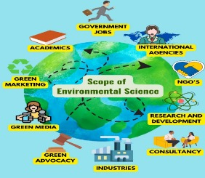
Role in Environmental Science: Statistics plays a significant role in environmental science by analyzing data related to climate change,pollution, and biodiversity. By employing statistical models, scientists can predict future trends and assess the impact of human activities on the environment

Slide 6
Baseline studies:
Document the current state of the environment to provide a background for future changes
Targeted studies:
Describe the likely impact of planned changes or accidental occurrences
Regular monitoring:
Detect changes in the environment
SEEA-Water:
A statistical framework that accounts for water stocks and flows in a country
Time series analysis:
Studies environmental quantities over time, such as monthly or yearly temperature, rainfall,
and humidity

Slide 7

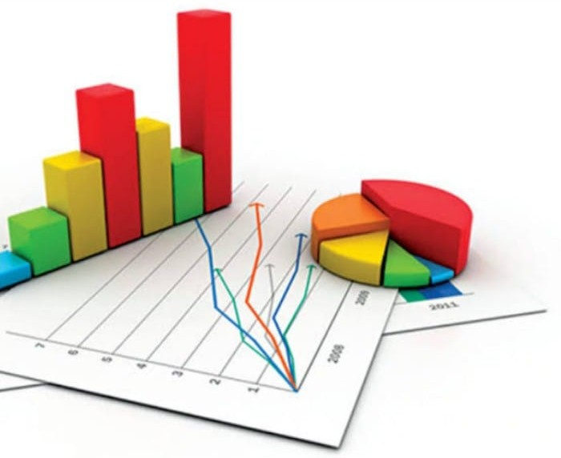
STATISTICS IN SOCIAL SCIENCE In social science, statistics is used to analyze demographic trends, conduct surveys and interpret behavioural data.This enables researchers to understand societal issues and inform public policy decisions, making it an essential tool for societal advancement.

Slide 8


STATISTICS IN BUSINESS In the business sector, statistics is used for marketing research, sales forecasting and performance analysis.companies rely on statistical methods to make data-driven decisions that enhance profitability and improve customer satisfaction.

Slide 9
FORECASTING: using past data to predict future sales. For example,a cafe can use last year’s customer data to estimate how many customers will visit next month. ANALYZING CUSTOMER DATA: A software company can analyze data to understand their spending preference. EVALUATING MARKETING CAMPAIGN: A company can use statistics to evaluate the impact of their marketing campaigns.

Slide 10
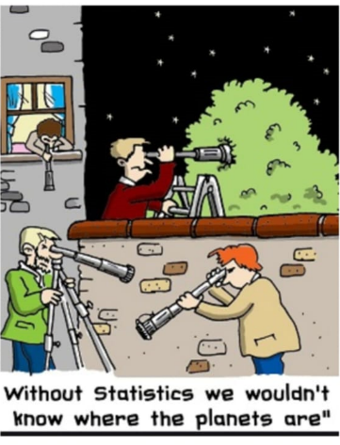
STATISTICS OF ASTRONOMY
Statistics in Astronomy Astronomical measurements often deal with large numbers of upper and lower limits.Knowledge of statistics is absolutely essential for an observational astronomerLack of repeatable experiments in astronomy makes probabilistic methods unusually important, while huge modem astronomical data sets provide an exciting real-world testing ground for innovative statistical techniques.The computer used in weather forecasting is based on the set of statistics functions. All these statistics function to compare the weather condition with the pre- recorded seasons and conditions.

Slide 11

STATISTICS IN CHEMISTRY
The statistical methods are applied in chemical studies for data collection and analysis of chemical compounds for more efficient management of flow of the information.They allow us to foresee physical and biological properties chemical compounds.

Slide 12

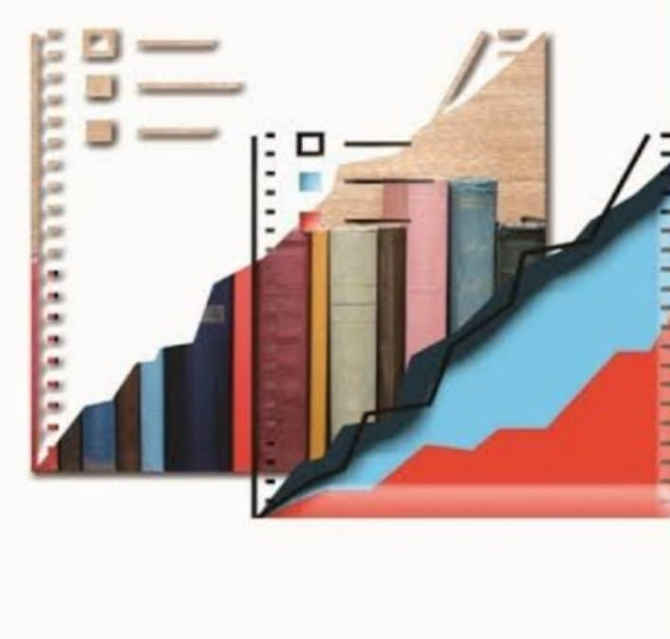
STATISTICS IN EDUCATION
MEASUREMENT AND EVALUATION ARE ESSENTIAL PART OF TEACHING LEARNING PROCESS.
IN THIS PROCESS WE OBTAINED SCORES AND THEN INTERPRET THESE SCORE IN ORDER TO TAKE DECISIONS
STATISTICS ENABLES US TO STUDY THESE SCORES OBJECTIVELY

Slide 13
CONCLUSION: THE POWER OF STATISTICS THE MULTIFACETED APPLICATION OF STATISTICS ACROSS SCIENTIFIC DISCIPLINES HIGHLIGHT ITS IMPORTANCE IN ADVANCING KNOWLEDGE AND IMPROVING PRACTICES. AS DATA CONTINUES TO GROW, THE ROLE OF STATISTICS WILL BE EVER MORE VITAL IN DRIVING INNOVATION AND INFORMED DECISION-MAKING

